Slide 1
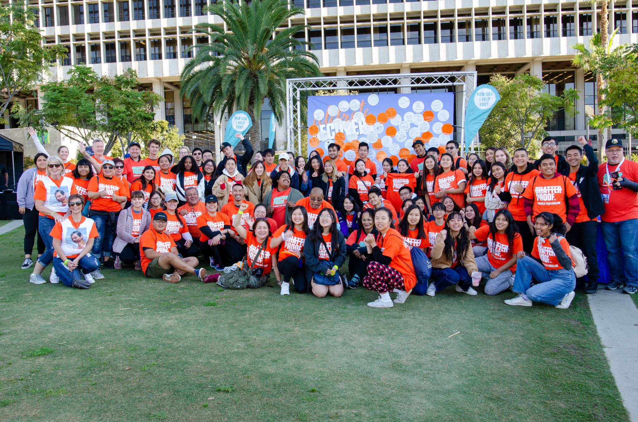

Slide 2
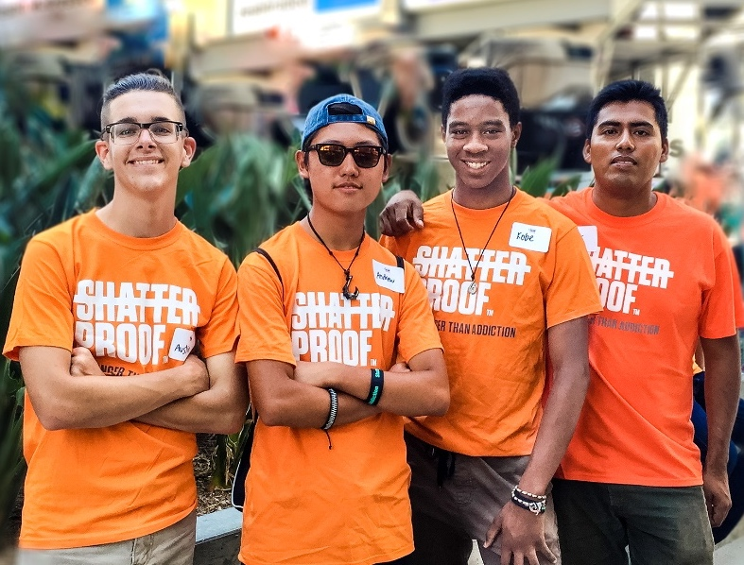
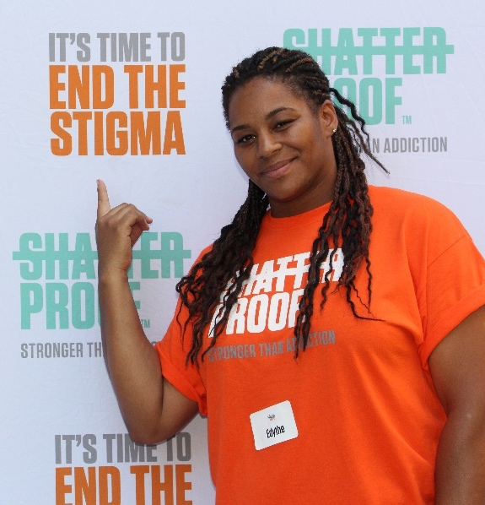
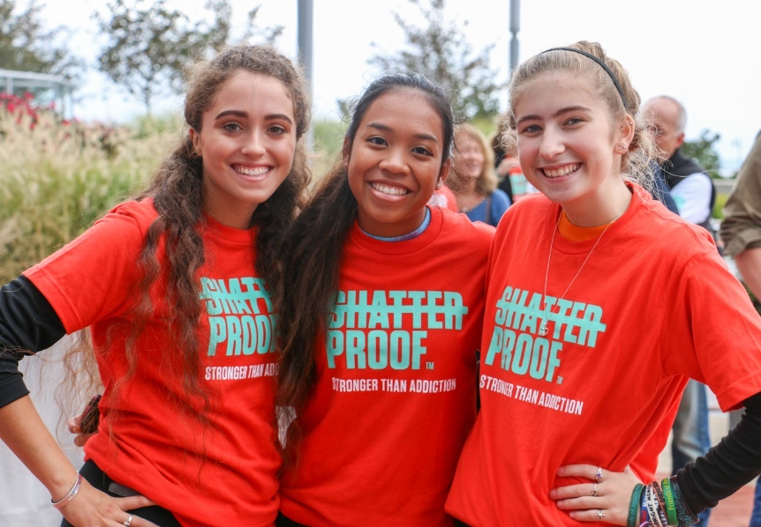
Our Mission
Founded in 2012, Shatterproof is a national nonprofit dedicated to reversing the addiction crisis in the United States.
Shatterproof harnesses the models of business, the rigor of science and the power of a national movement to create change and save lives through three pillars of work: revolutionizing the addiction treatment system, breaking down addiction-related stigmas and supporting and empowering our communities. To learn more visit www.Shatterproof.org.

Slide 3
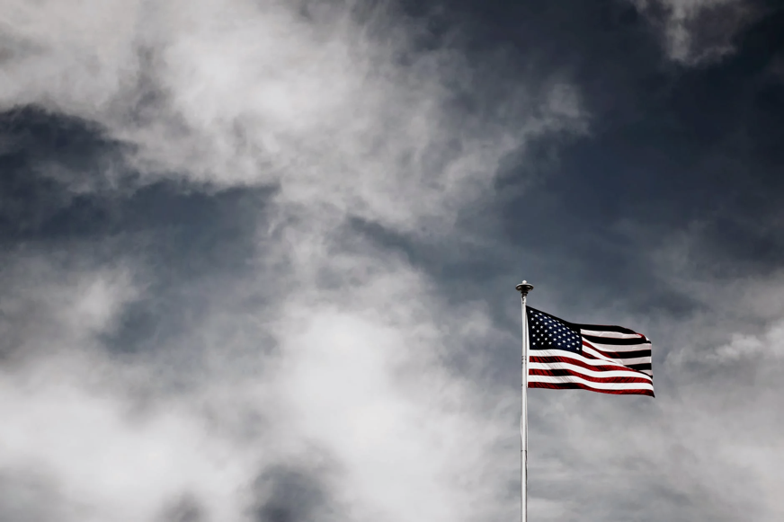
Addiction in America
40 million Americans struggle with addiction, but many don’t get the treatment they need. It doesn’t have to be this way.

Slide 4
Addiction in America
Addiction is a public health crisis.

Slide 5
Addiction in America
The addiction crisis is deadlier than ever before.
Overdoses are the #1 cause of accidental death in our country. According to the CDC, there were over 107,000 fatal overdoses in the U.S. in 2021.
That’s the highest number of overdose deaths ever recorded in a single year. Overdose deaths involving synthetic opioids such as fentanyl, psychostimulants such as methamphetamine, and cocaine all increased between 2020 and 2021.

Slide 6
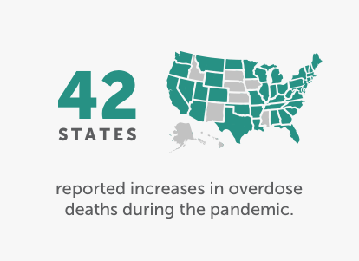
Addiction in America
Impact from COVID
During the COVID-19 pandemic, this tragedy has gotten worse. In some communities, overdose-related emergency calls are up as much as 40% and 42 states reported increases in overdose deaths during the pandemic.
And it’s not just overdoses taking lives: In 2018, more than 175,000 deaths in the U.S. were related to alcohol and other drugs. That makes substance use the third largest cause of death in the nation.

Slide 7
Addiction in America
While much of the coverage of the opioid epidemic has focused on white, rural populations, the epidemic affects white, Black and Latinx people proportionally.
In fact, overdoses are rising more quickly among communities of color. The annual growth rate from 2018 to 2020 for Black individuals (16.1%) and Latinx individuals (12.6%) well surpassed the rate of white individuals during the same period (3.8%). What's more, overdoses among Native Americans are above the national average, and the rate continues to grow.

Slide 8
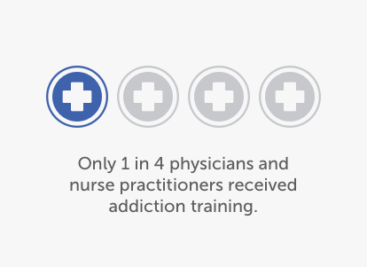
Addiction in America
Effective addiction treatment is hard to access and rarely covered by insurance.
Only 1 in 10 people who need treatment ever receive it, and even fewer receive high-quality care that’s rooted in scientific evidence. Medications are one of the most effective treatments we have for substance use disorder, but many cannot get them.
60% of residential treatment facilities don’t offer addiction medication and only 1% offer all three types of medications.

Slide 9
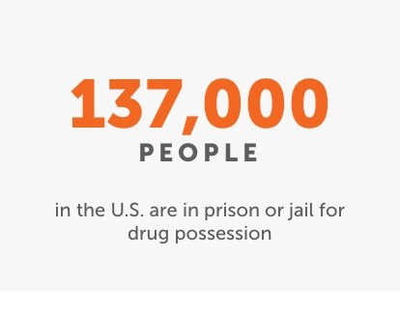
Addiction in America
People suffering from addiction receive punishment more often than treatment.
Approximately 137,000 people are in state prisons or jails in the United States on any given day for drug possession, often for possessing small quantities of illegal drugs.
And penalties are doled out inequitably: Racial and ethnic minorities, especially Black and Latinx Americans, are significantly more likely to be arrested and receive stronger sentences for drug-related offenses.

Slide 10
Addiction in America
It doesn't have to be this way.
Addiction costs our country more than $740 billion each year. And the costs keep rising. We’re hemorrhaging money on this crisis, and all that spending is not doing much to protect our loved ones.
With the science we have today, we could save countless lives — and spend a fraction of that amount —by increasing access to addiction treatment with an approach that’s compassionate, evidence-based, and rooted in public health.

Slide 11
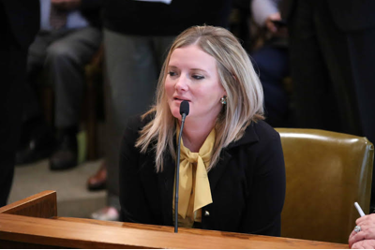
Addiction in America
You can help end the addiction crisis in America.
Learn about the issues and use your voice for change.

